Slide 1
neoclassical.ai
Fundamental Entities
Point Potentials
Notes:
Hi. Welcome to this episode of Emergent Nature.
My name is J Mark Morris. I go by Mark.
In this episode I’ll discuss the error that caused science to go off track into general relativity and quantum mechanics.
That may seem like an unusual thing to say, since general relativity and quantum theory are generally considered to be successful effective theories.
However, as we will see, an error circa 1900 threw science off track.
There is a parsimonious solution to nature.

Slide 2
The Fundamental Entities of Nature
1D Linear Time, 3D Euclidean Space, Point Potential Emitters
3D
Euclidean
Space
1D
Linear
Time
Electrino
Positrino
J Mark Morris

Slide 3
Point Potential Magnitude
Equal and Opposite with |q| = |e/6|
3D
Euclidean
Space
1D
Linear
Time
Electrino
Positrino
J Mark Morris

Slide 4
Point Potentials are Immutable
No known origin or demise.
3D
Euclidean
Space
1D
Linear
Time
Electrino
Positrino
Pair Production and Annihilation are Not Necessary in the Model
J Mark Morris

Slide 5
Point Potential Energy
Point Potentials are Constant Rate Emitters of Potential.
Action of Potential Emissions on Point Potentials Changes Energy.
3D
Euclidean
Space
1D
Linear
Time
Electrino
Positrino
J Mark Morris

Slide 6
Large Scale Point Potential Observables
Population Density.
Energy Density.
3D
Euclidean
Space
1D
Linear
Time
Electrino
Positrino
J Mark Morris

Slide 7
Constant Rate Point Potential Emitters
Intersecting magnitude | At emission, r = 0 | r > 0
v = 0 | |q| | |q|/(4 pi r²)
v > 0 | |q|/v | |q|/(v 4 pi r²)
3D
Euclidean
Space
1D
Linear
Time
Electrino
Positrino
J Mark Morris

Slide 8
Point Potential Have No Speed Limit
However, speed limits may arise in emergent assemblies.
3D
Euclidean
Space
1D
Linear
Time
Electrino
Positrino
J Mark Morris

Slide 9
More things to explain slowly in the slides above
PP are truly a point with constant rate emission. dq/dt = constant
show intersection of a potential sphere results in action
show how the receiving point potential has infinite solutions along the line defined by emission and reception
towards the partner if the partner is opposite, or away from the partner if the partner is a like potential
if v-emitter=0 then emission magnitude = |q| -- then q-received = q-transmitted/r.
regardless of v-emitter, it may be convenient to imagine a v-emitter = 0 and actual q to simplify the calculations.
also, how does v-receiver play in to this.
v-receiver = 0, no impact
for portion of v-receiver on a geodesic ?
for portion of v-receiver on the line to emission then calculation is different
how does gradient of potential factor in to action?
it is more work to move away from an opposite emitter, and towards a like emitter and vice versa.
J Mark Morris

Slide 10
Foundation for a Dynamical Geometry of Nature and the Universe
A unit potential is described by (sign, time, position, velocity) (-/+ δ, t, s, s’)
Like unit potentials repel. Opposite unit potentials attract.
The sum of all unit potential in the universe is zero.
The path of a unit potential is presumed to span all time to t=now.
Point potentials are acted upon by the local superposition of all coincident Dirac spheres.
A point potential with v < @ is inside its emitted Dirac potential spheres.
A point potential with v > @ is outside its emitted Dirac potential spheres.
Once a unit potential velocity crosses @ then self-action occurs.
Vector velocity orientation and magnitude of both the emitter and receiver are directly related to computing the action when crossing a Dirac sphere.
J Mark Morris

Slide 11
Thank You
Questions?

Slide 12
SCRIPT
The idea of point charges as fundamental building blocks of nature has played a significant role in the history of particle physics.
This concept emerged with the development of atomic and subatomic theories, particularly in the late 19th and early 20th centuries.
A "point charge" is an idealized model, representing an electric charge concentrated at a single point in time and space.
Prior to the discovery of the internal structure of the atom, early theories proposed that positive and negative charges could account for the observed electrical properties of matter.
Proton and Electron Identification:
J.J. Thomson discovered the electron in 1897 and it carried a fundamental negative charge (−e)
Ernest Rutherford demonstrated in 1911 the existence of a dense, positively charged nucleus.
Rutherford’s result lead to the identification of the proton as a fundamental carrier of positive charge (+e).
The early models of the atom, such as the Rutherford model, conceptualized the electron and proton as point charges.
Point charges were thought to define the atom's structure and behavior.
Theoretical Framework:
The proton and electron were initially regarded as indivisible charged point particles with no internal structure.
Their point-like nature was essential in early quantum mechanical formulations.
The Bohr atomic model (1913) used point charges, describing electrons in discrete orbits around a nucleus of protons.
Transition to Modern Understanding (Quantum Theory)
Experiments in inelastic scattering in the 1960s, revealed that protons have an internal structure of quarks bound by gluons.
Thus the proton could not be a point charge since it had internal structure.
The electron remains a point-like particle with no internal structure, consistent with the Standard Model of particle physics.
Though the point charge model was useful, it had theoretical issues, i.e., the infinite self-energy in classical electrodynamics.
Quantum field theory (QFT) addresses these infinities through renormalization.
h/t chatgpt
J Mark Morris

Slide 13
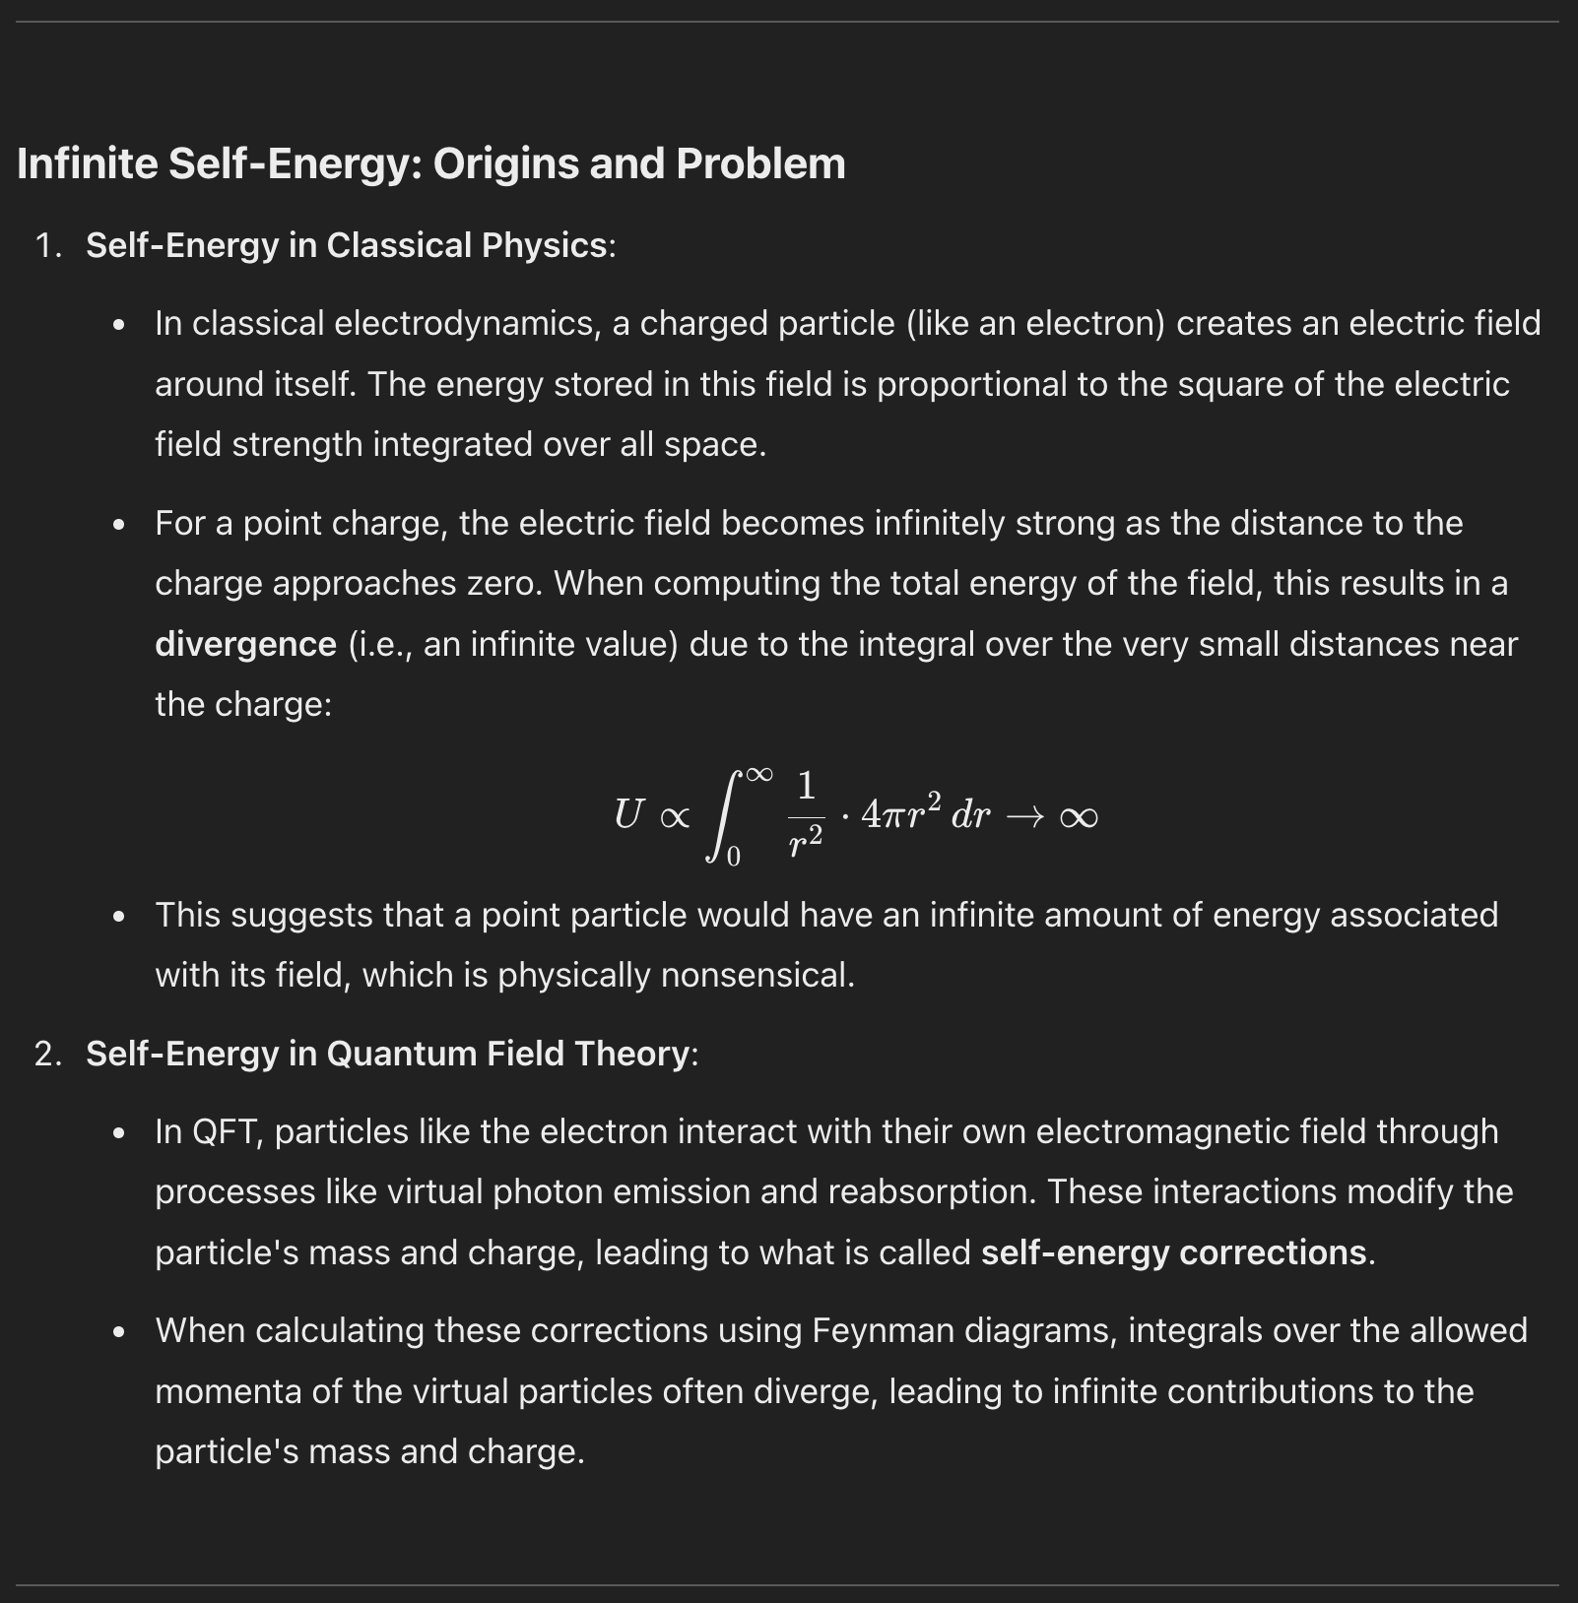
Point charges are confusing and incompletely modeled.
Instead, consider a point object which
emit potential at a constant rate
act in response to received potential (superposition)
are modeled as a Dirac delta at r=0 and q/r otherwise.
There are multiple ways the old concerns don’t matter.
there is only one case where the 1/r path is followed and that is the spiraling binary, which has a limit.
point potentials move through potential fields at ease
everything is superposition, relax
The self energy issues are a result of an ontology too far from base nature.
h/t ChatGPT
J Mark Morris

Slide 14
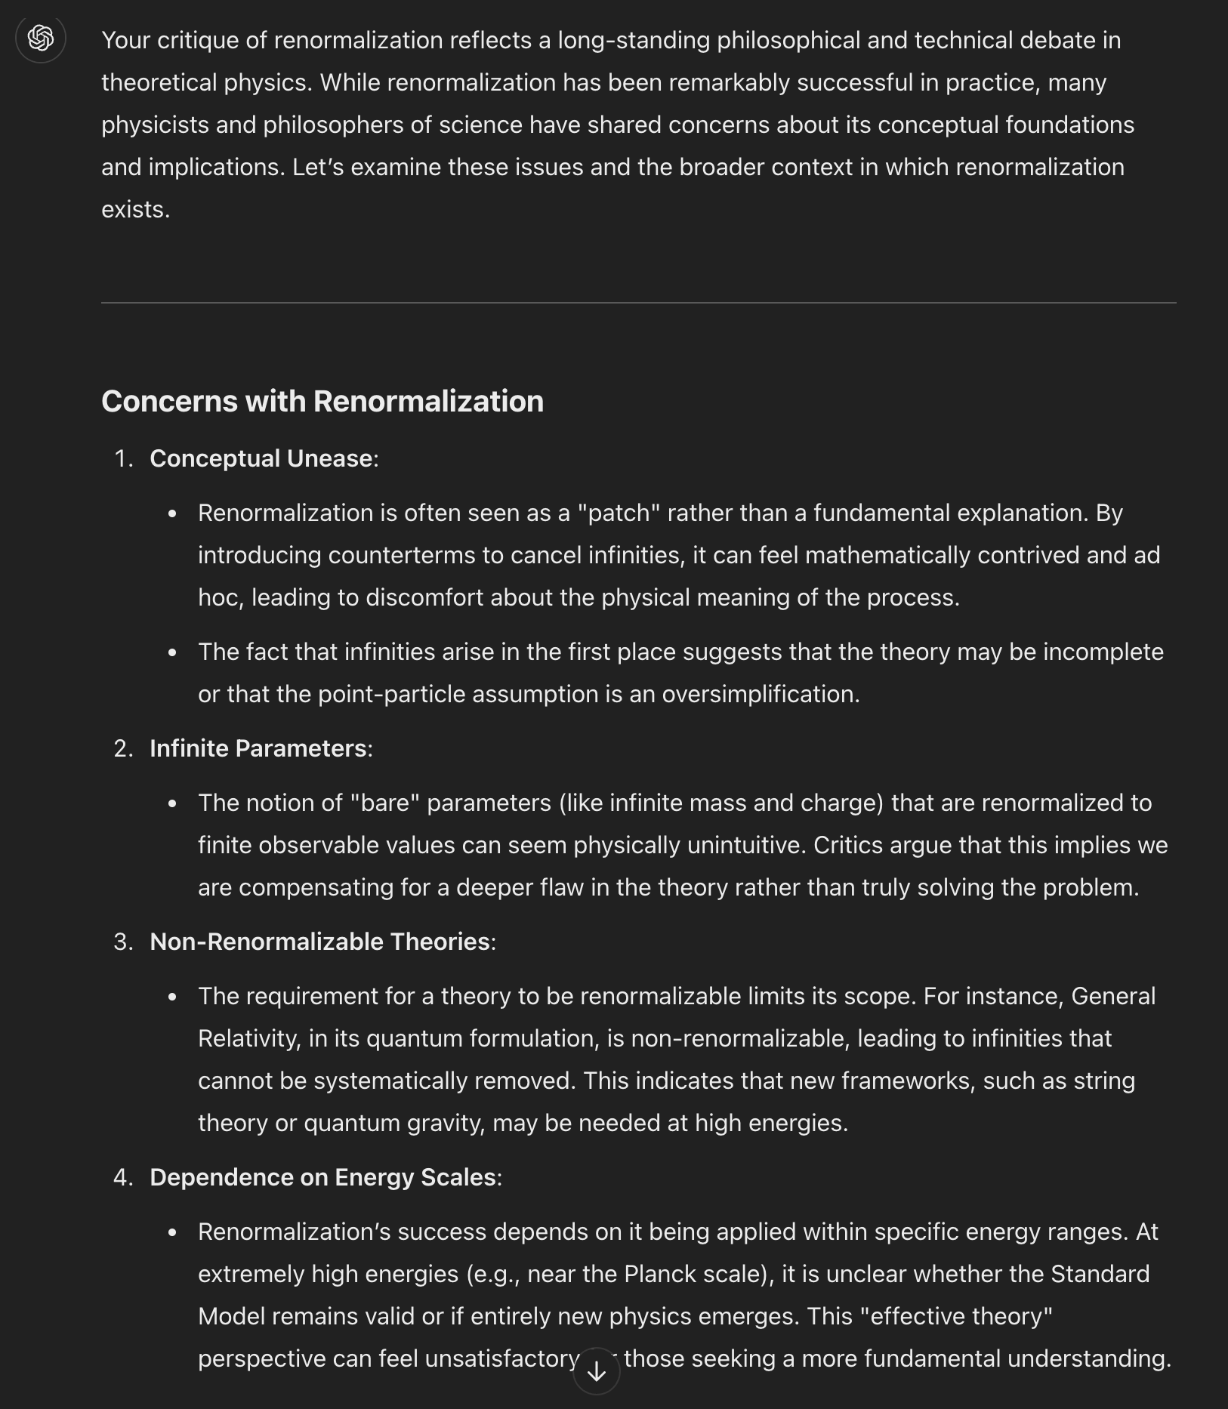
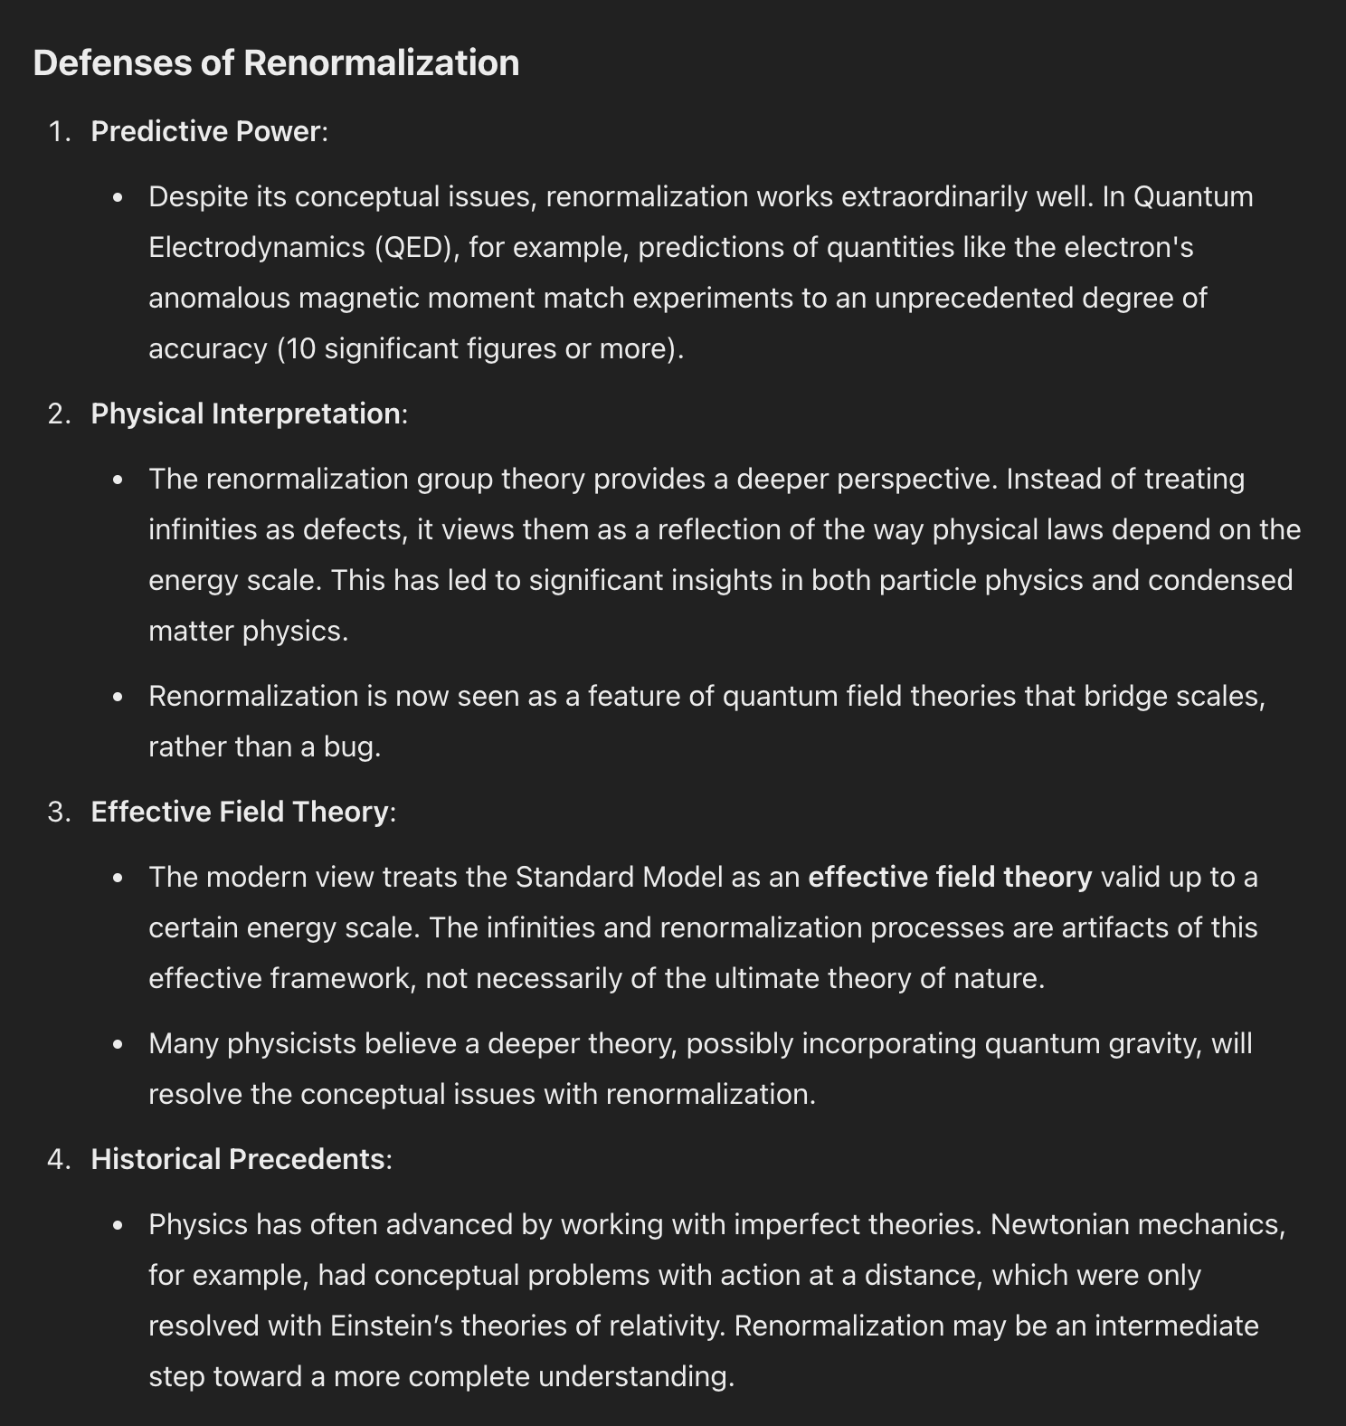
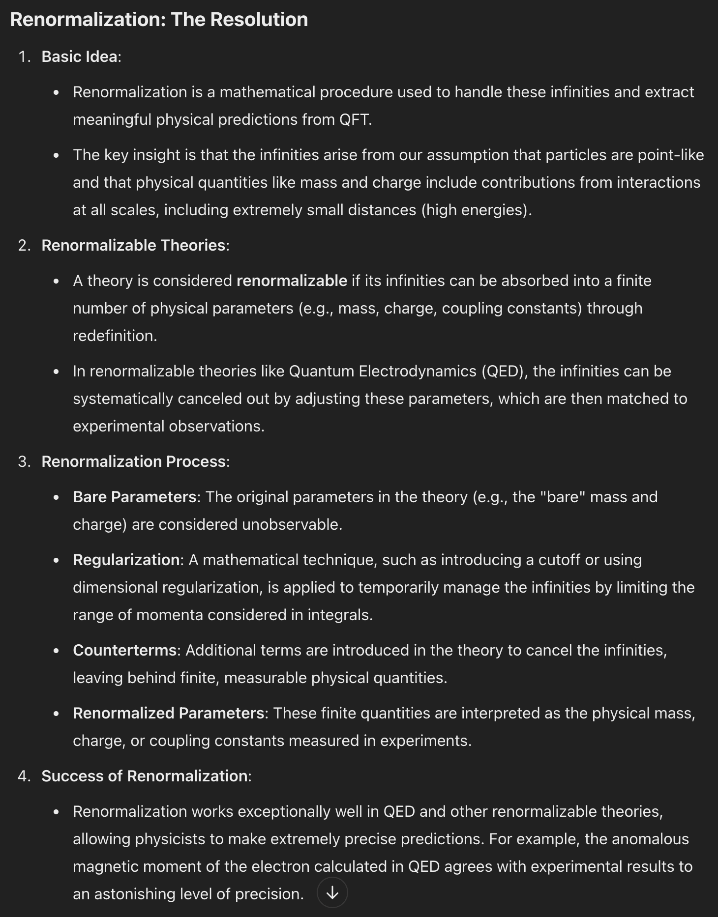
h/t ChatGPT
Seriously?
They gave up because of this issue?
And they had superposition?
And they knew about frequencies.
And had already considered orbits.
And knew about path history for point charges.
It boggles my mind how major challenges and paradox are considered as perplexing oddities to be ignored and yet we put on the blinders and use proxies like renormalization in the theories.
Are you kidding me?
J Mark Morris

Slide 15
Examining the Potential Field of 0, 1, or 2 Point Potentials
Use grad, div, curl to make fundamental obserations about the emissions of point potentials.
Use systems of up to two point potentials
Can any of these be proven geometrically?
Compare to Maxwell in Del form.
Region | No point potentials (does it match superposition?) |  |  |  | One moving point potential |  |  | A pair of opposite or same point potentials.
External Moving Point Potentials | None | One | Two opposite | Two same | None | One opposite | One same | None
Gradient of Potential | None | Based on path of emitters
Divergence of Potential | zero | zero | zero | zero | zero | +/- q | +/- q | zero
Curl of Potential | zero
J Mark Morris

Slide 16
Template
x
J Mark Morris

